Slide 1
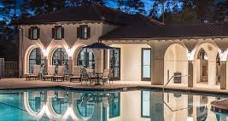
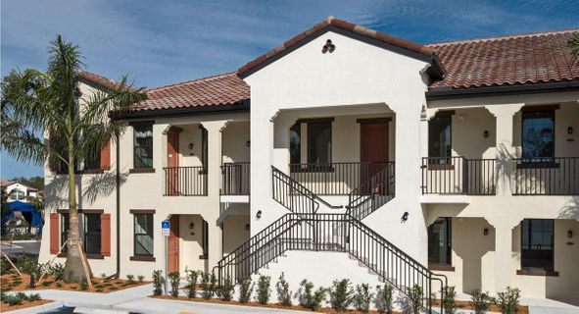
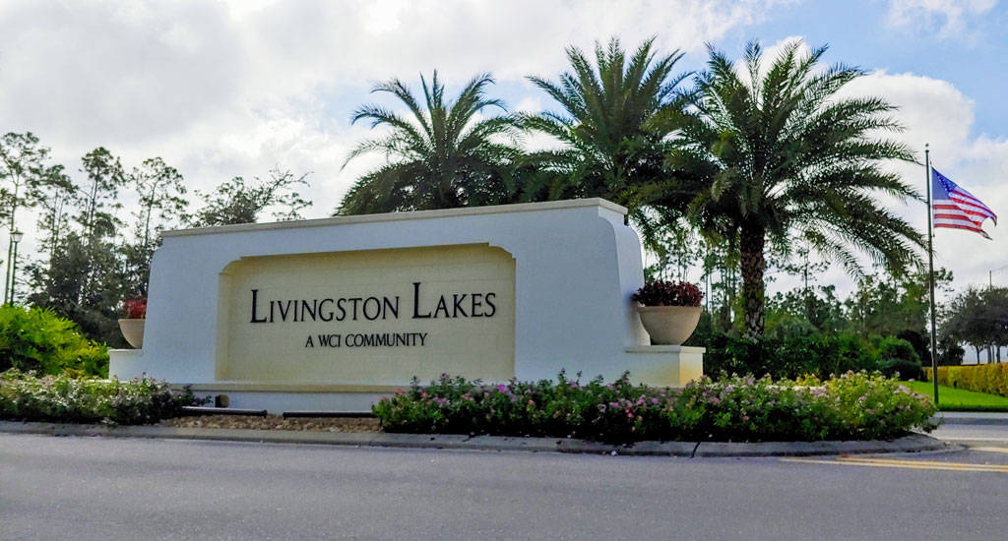
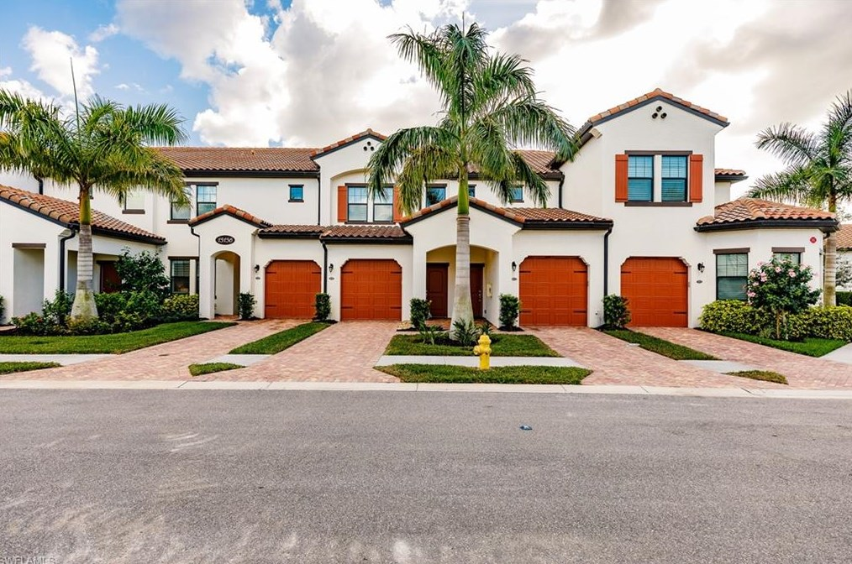
Livingston Lakes Annual Meeting
March 28, 2022

Slide 2
Contents
BOD Mission & Success
YE Financials
2022 Budget
Capital Improvements
Association & Homeowner Maintenance
Landscaping
Sales & Rental Trends
Investor Obligations
Resident Resources
Compliance
Social Events
Path Forward …

Slide 3
BOD Mission
Livingston Lakes continues to be a sound investment and sought-after place to live. Your BOD is truly vested in the many facets of Livingston Lakes community living.
Your BOD remains committed to protect and enhance property values, maintain fiscal health and enforce unbiased compliance to ensure Livingston Lakes remains a great community.
We appreciate your confidence, welcome the opportunity to serve and look forward to another successful year.
Condo Associations are Designed to Protect Property Values and Create Enjoyable Living Spaces for Residents

Slide 4
BOD/Association Success
Signs Of Successful Association Management
Strong Leadership
Smart Decision- Making
Responsible Budgeting
Successful Communication
Community Involvement
Transparent & Understanding
Meeting Clarity
Strong Compliance Enforcement
Seeks Assistance & Knowledge

Slide 5

YE Balance Sheet
Assets (12/31/2021)
 |  | ASSETS
CASH
Centennial OP#9908 |  | $ 376,132.07
Petty Cash |  | $ 250.00
 |  | $ 376,382.07
RESERVE REPLACEMENT FUNDS
Centennial Reserve #1373 |  | $ 555,444.04
Morgan Stanley Reserve |  | $ 169,999.90
 |  | $ 725,443.94
ACCOUNTS RECEIVABLE
Assessment Receivables |  | $ 1,137.31
 |  | $ 1,137.31
OTHER CURRENT ASSETS
Prepaid Insurance |  | $ 28,779.83
Prepaid Expenses |  | $ 13.51
Prepaid Alarm Monitoring |  | $ 14,588.73
Utility Deposits |  | $ 156.00
Due From Reserves |  | $ 1,500.00
 |  | $ 45,038.07
TOTAL ASSETS |  | $ 1,148,001.39

Slide 6
DEFERRED LIAB REPLACEMENT- CARRIAGE
Reserve Total | $ 200,797.00
DEFERRED LIAB REPLACEMENT- COACH
Reserve Total | $ 183,058.44
DEFERRED LIAB REPLACEMENT- GARDEN
Reserve Total | $ 247,021.68
FUND BALANCE INTEREST
Interest | $ 14,644.14
FUND BALANCE
Capital Contribution | $ 115,000.00
Prior Year Surplus (Deficit) | $ 261,631.10
Current Year Net Income (Loss) | $ (133,659.44)
 | $ 242,971.66
TOTAL | $1,148.001.39
YE Balance Sheet
Liabilities (12/31/2021)
What Does This Mean? Living Lakes is A Non-Profit Condominium Association and By Law, Cannot Show Excess Assets at YE Without Incurring Tax Implications. Therefore, YE Balance Sheet Assets Must Match YE Liabilities.
 | LIABILITIES
CURRENT LIABILITIES
Accounts Payable | $ 43,755.14
Prepaid Owner Assessments | $ 116,117.65
Due to Operating | $ 1,500.00
Deferred Income-Interest | $ 19,713.00
 | $ 181,085.79
DEFERRED LIAB REPLACEMENT- COMMONS
Reserve- Pavement | $ 15,372.00
Reserve- Pool | $ 2,803.00
Reserve- Clubhouse | $ 6,092.00
Reserve- Clubhouse Roof | $ 3,725.00
Reserve- Clubhouse Furniture & Equip | $ 18,287.44
Reserve- Mailboxes | $ 13,064.68
Reserve- Lift Station | $ 13,873.68
Reserve- Monument & Walls | $ 5,204.00
 | $ 78,422.68
TOTAL

Slide 7
YE Reserves-
Common Area
COMMON AREA
 | Replacement | Useful | Remaining | 12/31/2021 | Amount | Annual
Description | Cost | Life | Life | Balance | To Be Funded | Contribution
Pavement | 75,000 | 25 | 21 | 15,372 | 59,628 | 2,981
Pool | 10,000 | 15 | 11 | 2,803 | 7,197 | 720
CH Painting | 8,000 | 7 | 3 | 6,092 | 1,908 | 954
CH Roof | 20,000 | 25 | 21 | 3,725 | 16,275 | 795
CH Furniture & Equip | 25,000 | 7 | 4 | 18,287 | 6,713 | 2,238
Mailboxes | 40,000 | 20 | 16 | 13,064 | 26,936 | 1,796
Lift Station | 40,000 | 15 | 11 | 13,873 | 26,127 | 2,613
Monument & Walls | 15,000 | 15 | 11 | 5,204 | 9,796 | 980
 | 233,000 |  |  | 78,422 | 151,580 | 13,077

Slide 8
YE Reserves
CARRIAGE HOMES
 | Replacement | Useful | Remaining | 12/31/2021 | Amount | Annual
Description | Cost | Life | Life | Balance | To Be Funded | Contribution
Roof | 669,200 | 25 | 21 | 133,551 | 535,649 | 26,764
Painting | 77,000 | 7 | 3 | 55,113 | 21,887 | 10,943
Fire Alarm Systems | 72,800 | 30 | 26 | 12,133 | 60,667 | 2,427
 | 819,000 |  |  | 200,797 | 618,203 | 40,134
COACH HOMES
 | Replacement | Useful | Remaining | 12/31/2020 | Amount | Annual
Description | Cost | Life | Life | Balance | To Be Funded | Contribution
Roof | 434,000 | 25 | 21 | 87,737 | 345,888 | 17,294
Painting | 112,000 | 7 | 3 | 82,559 | 29,441 | 14,720
Fire Alarm Systems | 756,000 | 30 | 26 | 12,762 | 743,238 | 2,514
 | 1,302,000 |  |  | 183,058 | 1,118,567 | 34,528

Slide 9
YE Reserves
GARDEN HOMES
 | Replacement | Useful | Remaining | 12/31/2021 | Amount | Annual
Description | Cost | Life | Life | Balance | To Be Funded | Contribution
Roof | 551,070 | 20 | 16 | 140,709 | 410,361 | 27,332
Painting | 90,000 | 7 | 3 | 66,973 | 34,539 | 11,513
Pavement | 126,000 | 25 | 21 | 25,640 | 105,378 | 5,018
Fire Alarm Systems | 81,000 | 30 | 26 | 13,699 | 69,993 | 2,692
 | 848,070 |  |  | 247,021 | 620,271 | 46,555

Slide 10

2022 Budget
2022 Approved Budget Mailed to All Owners
First Ever Minimal $17 Mthly Fee Increase
US Rate of Inflation Climbed Again in January to 7.5% * (40-year high) and is Expected to Continue Throughout 2022. However, Fed Preannounced Decision to Raise Interest Rates Quarter Point with More Increases Throughout 2022.
Received Market Driven Increases from Service Providers, Suppliers, Contractors & Utilities
BOD Able to Negotiate Favorable Terms and Maintain Sound Financial Position
Mandatory Multiple Quotes
* Market Watch Economic Report, Feb 10, 2022

Slide 11
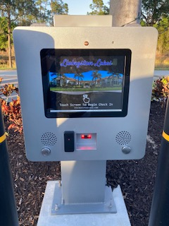
Capital Improvements
Entrance Monument Enhancement
Deep Well Installation- Supply Lakes with Water for Landscape Irrigation
Lake Fountains Aesthetic Enhancement
CheckPoint Kiosk Gate Entry System
HOAst Technology to Enable Online Surveys

Slide 12
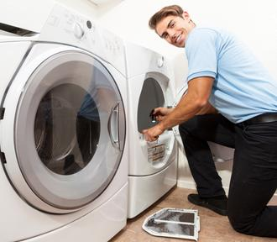
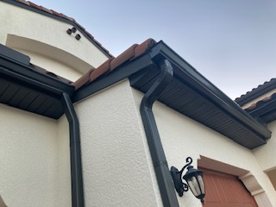
Association Maintenance
Your Assessment Dollars Pay For-
Sealcoating Roadways & Parking Pads
Lake Maintenance
Landscaping- Mowing, Mulching and Trimming
Clubhouse Cleaning (2x’s a Week) & Dumpster Area Cleaning
Annual Dryer Vent & Common Drain Cleaning
Soffit & Fascia Inspection & Repair
Club House Cabana & Furniture Replacement, Addition of Streaming Service, Fireplace Repair
Lantern Lightbulb Replacement & Installation
Annual Building Exterior Power Wash
Roof Tile Inspection & Replacement
Annual Fire Equipment Inspection & Testing
Pest Control Applications

Slide 13

Homeowner Maintenance
AC Maintenance Every 6 Months. Recommend AC Filter Replacement Every 30 Days
Monitor Hot Water Heater for Leaks and Replace if Needed
Smoke Detector Testing Recommended Every Month. Battery Change Recommended at Each Time Change
Window/Screen Maintenance & Replacement
Lanai Power Washing
Strongly Recommend Hiring HOME WATCH Company for Seasonal Owners or Absentee Landlords
HOME WATCH Information to be Recorded with Paramont Property Management

Slide 14
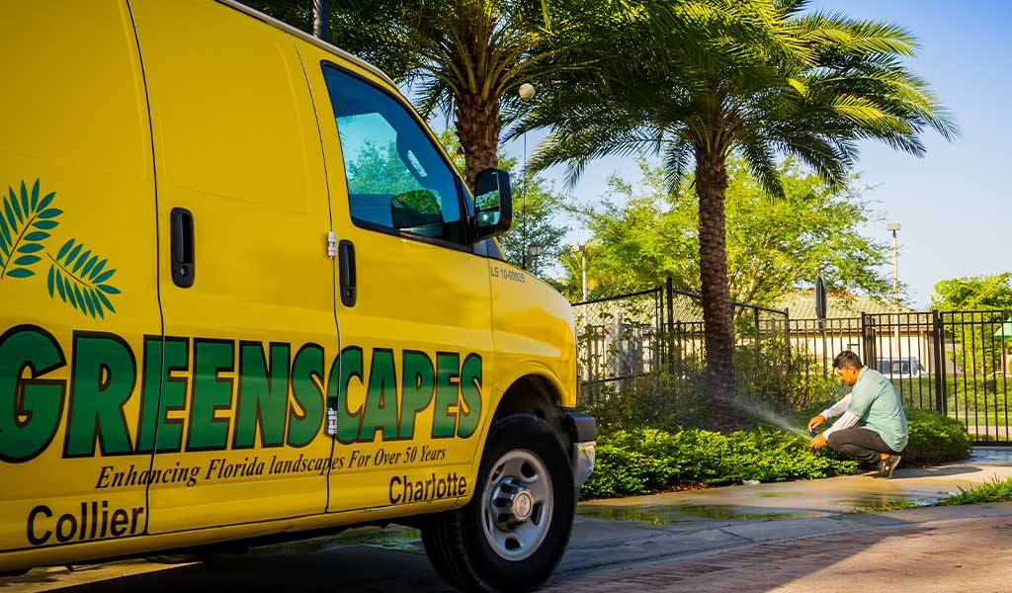
Landscape
Maintenance
Please Report Any Landscape Concerns Directly to Paramont Property Management and Please Do Not Interfere with Ongoing Work. Paramont Will Address Concerns with Both the Board and Greenscapes. Your Cooperation is Greatly Appreciated!
Renewed Greenscapes Contract for 2022 Season
Negotiated Additional Palm Frond Pick-Up
Mowing, Blowing and Trimming
Annual Mulching
Annual Palm Tree Trimming
Seasonal Annual Planting
Irrigation Repairs
Supplemental Turf Fertilization- CarbonPro-G
(soil optimizer)

Slide 15
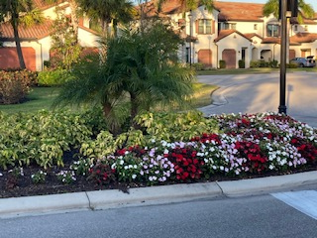
Landscape
Improvements
Phase 2- Entranceway Landscape Enhancement
Carriage Home Landscape Enhancements Complete
Coach Home & Garden Home Landscape Enhancements Planned for 2022-2023

Slide 16

Sales Trends
Style | Address | Unit # | Sq Ft | Size | Listing Price | Date Sold
Garden Home | 15102 Palmer | 203 | 1250 | 2 Bed/2 Bath | $425,000 | 3/4 2022
Coach | 15141 Palmer | 201 | 1786 | 2 Bed/2 Bath | $625,000 | 1/12/2022
Carriage | 15202 Butler | 101 | 1838 | 2 Bed/2 Bath | $520,000 | 1/11/2022
Carriage | 15205 Butler | 102 | 1823 | 2 Bed/2 Bath | $500,000 | 12/15/2021
Carriage | 15173 Butler | 202 | 2152 | 3 Bed/ 2 Bath | $520,000 | 12/10/2021
Coach | 15157 Palmer | 203 | 1786 | 2 Bed/2 Bath | $550,000 | Pending
Reflects Sales Data as of 3/15/2022

Slide 17
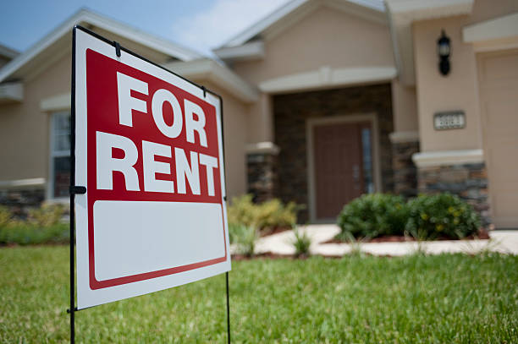
Rental Trends
49 Total Rentals within Livingston Lakes
Garden Hones -33 Total
Coach Homes- 11 Total
Carriage Homes – 5 Total
Monthly Rent Increases Evident Nationally and Throughout Naples

Slide 18
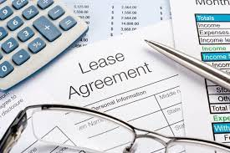
Investor Obligations
Owner’s Responsibility to Track Lease Expiration and Execute Lease Renewal
Renewals Due to Paramont Property Management Within 15-Days of Lease Expiration Date (hand-delivered or mailed, 1-sided documents)
Tennant to Contact Paramont Property Management for Proper Vehicle Registration & FOB
Owner’s Responsibility to Confirm Tennant is Aware of Rules & Regulations
Paramont Property Management is the Association’s Property Manager and NOT Investor’s Personal Property Manager
Failure to Comply With Above Will Result in Fines

Slide 19
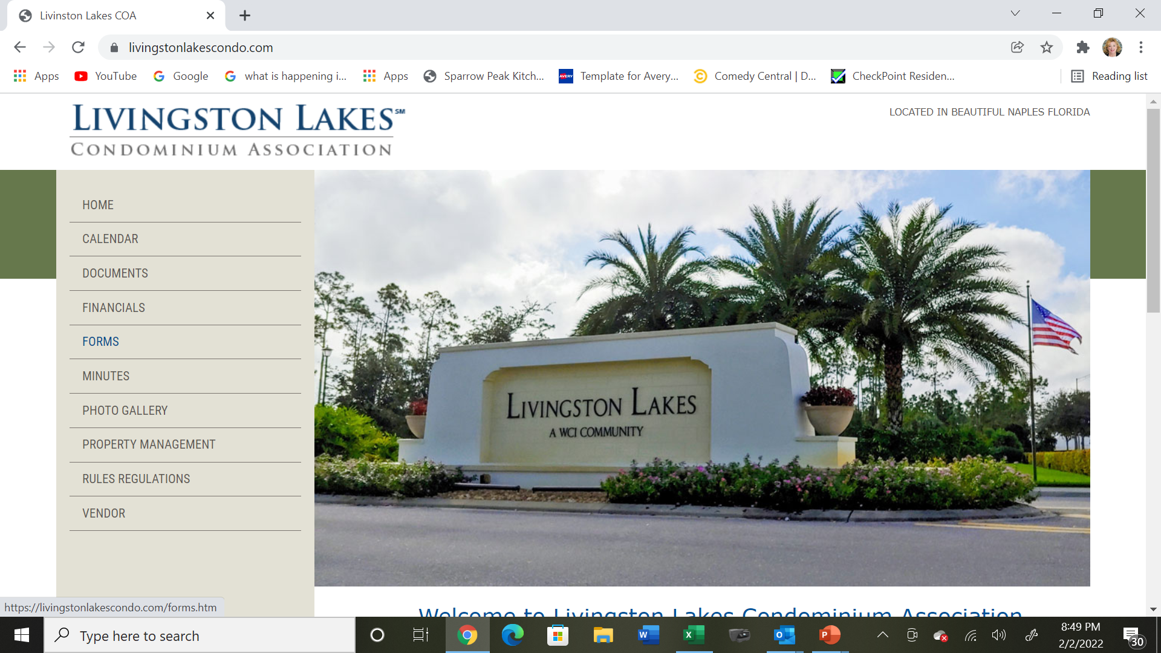
Resident Resources
Paramont Property Management, paramontproperty.com, 239-734-3200
Paige Berman, CAM, pberman@paramontproperty.com
LL Website is Resource for Rules & Regulations, Meeting Minutes, Declarations, Forms & Much More

Slide 20
Compliance
Commitment to Compliance Rules to Ensure Community Health, Safety and Beauty-
Parking Encroachment Violations
Pool Violations for Excessive Noise, Ball Throwing, After-Hours Access and Inflatables
Windows & Sills Free of Ornamentation
Resident & Guest Vehicle Registration
Unapproved Items in Common Areas (Gas Grills in Driveways)
Lanais for Patio Furniture and Decoration Only (No String Lights)
No Storage of Bicycles on Lanais. Please Use Common Area Storage Unit/Bicycle Rack
All Trash Placed in Trash Containers. No Trash Can Be Left Outside of Containers

Slide 21
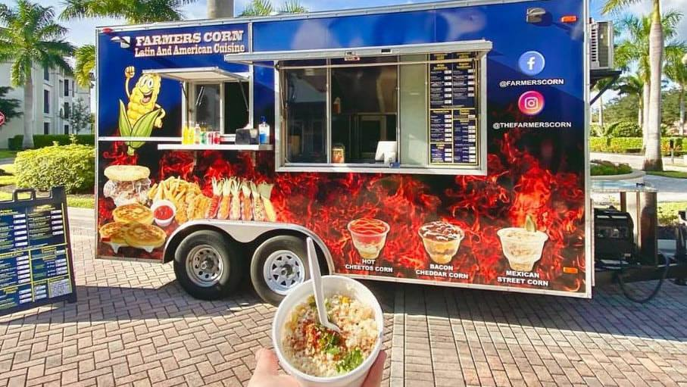
Social Events
Friday Night Food Trucks
Dinner & Dancing Into 2022
Valentine’s Party
Ladies’ Night
St. Patty’s Day
Greek Night
Thanks to All Our Wonderful Volunteers Who Make These Events A Success!

Slide 22
Future Path
Upcoming Vote- Garden Home Proposed Amendments to Address Critical Issues Related to Occupancy and Leasing. Recent Townhall Meeting Offered Information to Vote Planned for March. 140 Carriage & Coach Homeowners (majority) Passed These Amendments in 2020 and Request Garden Home Support in Adopting Amendments
Upcoming Survey- Rule 3.3.4 Prohibiting Inflatable Use in Pool. Survey to be Provided Through HOAst, Allowing Owners Opportunity to Vote Whether They Are FOR or AGAINST Their Use
Maintain Fiscal Health
Commitment to Open and Timely Communication
Enforce Unbiased Compliance

